Slide 1
Architecture Plan for Multiple SRM Scenarios
2022 November 18 meeting
Chuck Turnitsa, NATO NCDF Data Lake Architecture TT Lead

Slide 2
Agenda – Nov 18
Discuss email conversation, re: Multiple SRM experiment scope
Our current proposed experiment (Cyber, MTF, alterations to core SRM)
Our regular Architecture work, calls for at least 3 different considerations (CWIX, Spiral 5, Future); should our Multiple SRM work call for similar considerations?
What would be included in a current (i.e. CWIX experiment) Multiple SRM architecture?
Changes to Architecture?

Slide 3
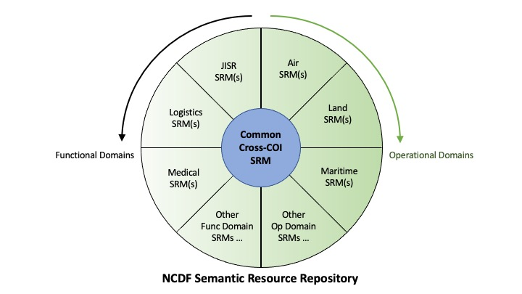
Multi-SRM Environment
Implications
As per our statement, each Community will manage their own SRM
There is a Common Cross-Community SRM (the NCDF SRM)
Questions
Will there be an overall archive or repository of SRMs
What other Semantic supporting documents should be covered? (ref: Phil’s question vis Ontology Concerns)
Notes:
Scott Renner – This is a great idea, but the idea of the Repository will be useful to other communities beyond the NCDF architecture group
Mark Dotson – Change the focus/name from NCDF SR Repository (or environment) to NATO SR Repository (or Environment)
Scott – An NCDF interoperability supporting IEPD could serve as the basis for systems exposing their Semantics

Slide 4
Email conversation (1)
1st email from Woody
Charles, All,
Sadly, I do not get the issue with multiple SRMs for the data lake. What exactly are we trying to achieve with “Multiple SRM Scenarios”?
Focusing on slides 10 and 13, of course there are independent community SRMs. And to exchange information between those communities, there is a need for a core SRM, which will be the Common Cross-COI SRM (CXCSRM). So all we need to take care of with the data lake is (1) the CXCSRM, and (2) the mappings between community SRMs and the CXCSRM. Where is the logical difference to what we are doing today? I fail to see it.
Or is the whole idea to use something else as the core SRM, i.e. to replace the not yet existing CXCSRM? I think the focus should be first on clearly defining the NCDF, the CXCSRM, etc., before letting the scope creep.
Best regards,
Woody

Slide 5
Email conversation (2)
2nd Email from Fahri
Dear Woody and all
I agree with your understanding on the subject.
At this point it is better to be clear and less complicated than it needs to be. We have a large community waiting deliverables from this popular group (as I see it, since I heard DM CaT business being cited in PPTS at Data and AI Senior Leaders Conference, today at NATO HQ).
And I believe there is one such core/common cross-communities SRM which is CXCSRM as Vision Paper clearly states.
I also understand Chuck and his team’s endeavor within the context of testing NCDF&DL at CWIX. But we can only mention of a View Model (for a specific purpose) as generated/derived from CXCSRM not a standalone NCDF SRM.
Thank you all for your dedicated support. Proud being part of DM CaT.
Regards,
Fahri

Slide 6
Email Conversation (3)
3rd Email, from Phil Guy
Dear all
This multi-SRM stuff is new territory and we are making it up as we go along (in the words of Indiana Jones).
To my simplistic view, the whole point of SRMs is about “understanding information”.
Current situation
We have the MIM as SRM. Any information provided in MIM terms the data lake “understands”.
Any mapping between a COI SRM and the MIM is done outside of the data lake, and is implemented in the external transformation services (either incoming or outgoing).
Multi-SRM situation
Let us assume we have multiple COI SRMs within the data lake. This means that the data lake “understands” information from these COIs.
Any information coming from (or going to) one of these COIs requires little/no mapping to NCDF, because the data lake understands the COI SRM.
But to move information between COIs, the data lake needs a Core SRM, plus IESs between the COI SRMs and the core SRM (a role currently filled by the MIM and the external transformation services).
In short, it all boils down to extending the scope of information that the data lake “understands” and moving the responsibility for cross-community transformation inside the boundary of the data lake.
[Note that there may still be some external transformation required from specific message types to NCDF-COI SRM formats]
At least, this is how it works in my mind….
Kind regards,
Philip Guy

Slide 7
Email Conversation (4)
4th Email (from Fabian) Part 1
Hi Phil,
Whist I agree with a lot of what you are writing, I do have some areas that I may interpret differently.
Current Situation:
1 logical information model (the MIM) which we have adopted as an SRM.
The MIM is large, and provides many semantics, and in addition some CoI specific structure.
When talking about the data lake this means that all CoI are required to transform all their data into the lake following the structure provided.
Multi-SRM Situation:
In this approach the CORE SRM (blue dot in the middle) only contains semantics that are shared across more than 1 CoI.
There should be no CoI specific structure in the CORE SRM.
In the CoI SRM however the model will contains CoI specific structures to ‘arrange’ semantics according to the CoI needs.
When talking about the data lake all CoI only have to ‘transform’ to the core semantics.
When inserting information into the lake these core semantics are provided as (meta)data, and in addition the CoI specific data or a link to retrieve it.
When the lake needs to pass information from 1 CoI to the other, it need not transform, as the receiving CoI will understand the core data.
(there is no need to transform the CoI specific data from the source, as the destination will not understand it.)
From a search perspective the CoI can provide CoI semantics as coi specific (meta)data.

Slide 8
Email Conversation (5)
4th Email (from Fabian) Part 2
Technical advantages:
The CORE SRM is limited in size, which also means implementation of the lake will require less schema for the core semantics.
The data in the lake has the actual CoI data, or a link back to it.
Other advantages:
The CORE SRM is (will be) a NATO product, maintained and governed by NATO.
CoI need to ensure that alignment occurs this will not be a NATO responsibility.
Consequences:
NATO will have to staff and fund the development of the CORE SRM.
In addition NATO CoI will need to start the alignment process, and also staff this.
I’m not sure if we are thinking along the same lines, but this is how I have come to understand this road we are travelling.
I hope this makes sense, we’ll speak soon!
Regards,
Fabian

Slide 9
Scope of Experiment
Do we have two different “versions” of the API services?
These can be the same software
Who will develop? NCIA?
Will have to differentiate message checking and handling based on different SRMs?
Do we develop a small, proof of concept blended SRM?
A blend of MIM elements and something else?
An extension to NCMF meta data?
Two types of CWIX experimentation/testing –
First, FMN Spiral 5 work, similar to last year, based on existing MIM based SRM
Second, new experimentation with a different SRM – to establish this work – may be blend of two other models

Slide 10
Cyber experiment
Chuck Chipman – working on six different messages, for the CWIX experiment
Based, mostly but not entirely, on MTF
Have sets, and fields
New sets – cyber based
Making these messages NCDF conformant
Experimental SRM – that is conformant with the NCDF format (Naming Design Rules NDR)
Three SRMs – one based on MTF, one on CYBER, one on NCDF core (MIM)
Notes:
Comments from Mark – based on conversation with Phil
1. Take cyber messages (Estonia AFRL) – map them so that the internal NCDF core model can ingest them (i.e., aligned with MIM)
2. Make this work with the NCIA version of the Datalake.
3. Purpose: See if the resulting mapping can be used for ingest and search in the datalake, and if they come back to the Estonia systems intact.
Question from CC – Does the NCDF Naming Design Rules description align with the NCDF core – is there more to it than is in the NDR?
Need to have a meeting between DataLake persons and Cyber community to discuss the messages, and how/what will be mapped.

Slide 11
Changes to Architecture
Will this change the architecture?
Multiple software packages to react to an incoming message?
Differences in how the data lake handles messages internally?
One type stored in one spot; one type stored somewhere else?
External changes (i.e., access to data lake)
Internal changes (i.e., changes to services and internal software, data store, etc.)
Test cases – for the Multi-SRM experimentation, will they be variants or shadow versions of the main test cases, or will they be a separate set of test cases…

Slide 12
What artifacts will need to be developed?
Various NAF artifacts are already planned for CWIX 2023, for the regular Architecture TT task
Will there need to be variants for the Multi-SRM work?
New artifacts?

Slide 13
Overall Architecture goals for CWIX 2023
Cross-Community Communications remains overall goal for NCDF Data Lake Architecture
Support CWIX 2023 Objectives
FMN Sp5 Service Instructions for Federated Data Lake
Provision, Search and Retrieval using the NCDF Semantic Reference Model
Experiment with Federated Searching of BSOs provided to NCDF Data Lake, including Community Specific metadata
Experiment with retrieval of BSOs from NCDF Data Lake, in both NCDF and Native Formats
Experiment with the use of a Common SRM in querying and interpretation of results from NCDF Data Lake
SD
CM
ND
SD
DF
SD
CM
DF
ND
SD
DF
SD
CM
DF

Slide 14
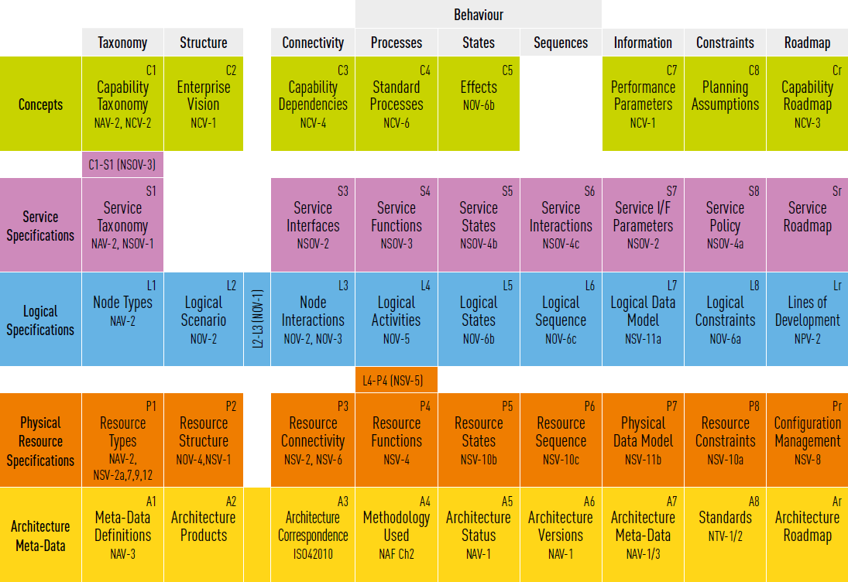
Notes:
Get spiral 5 architecture done
Distinguish between near term (CWIX) use case architecture, and long term “inside-the-lake” architecture
Conceptual and Logical specifications/views will be useful if done in different versions, for near term, spiral 5, and future

Slide 15
Backup
Earlier discussions, and earlier versions of slides

Slide 16
Agenda – Nov 04
Architecture to represent multiple SRM experimentation at CWIX 2023
Scope of experiment
How does it affect the architecture
What artifacts need to be developed

Slide 17
NATO and NCDF Semantic Reference Model (SRM) Statement
A single, comprehensive SRM for all NATO semantics is doomed to failure and is not a viable option
A dynamic environment that includes semantics from multiple SRMs is needed—this will be hard, but necessary
The NATO/NCDF SRM effort will be separate from MIM/STANAG 5643
Intent is that STANAG 5643 moves forward, independent from work here
A NATO/NCDF semantic environment will include a subset of MIM semantics, and likely form the initial set of NCDF semantics
A goal of the NCDF semantic environment is to facilitate cross-Community exchanges
Interchange can be supported by using atomic concepts, mapped to semantic meaning of data from different communities
Community SRMs will be independently governed by each Community
Community SRMs are independent, and those communities will manage their SRMs as they desire/require (Proposed)
Format of an SRM – No requirement for a community to represent its SRM using any technology or format
Every SRM should provide schema for its exchanges
The harmonized semantics across the Communities represents the universal intersection that interoperability can rely on
A NATO/NCDF semantic environment will be governed by NATO
Models and standards may be managed elsewhere, but when they are brought into the NATO semantic environment, NATO will govern their inclusion.
Changes to SRMs will require that NATO be aware of them, and handled, within the semantic environment.
The Core SRM (and associated interoperability mechanisms) need to be exposed and accessible as at least one technical artifact(Proposed)
There needs to be a link between Core SRM and any Community SRM, that needs to be based on a defined set of overlapped semantics (Proposed)
These statements are a distillation of remarks made during DM CaT and Syndicate meetings and amplified by discussion at CWIX 2022 and during special SRM sessions of the NCDF Data Lake Architecture Tiger Team.
Proposed Statements to be approved by DM-CaT/
Notes:
Sept 16 – We need a statement about what the higher level Semantic Fabric (Lanzo) is, and how it is working for the DataLake and mappings to community SRMs
Maybe a statement before the last two Proposed statements that defines a Semantic Fabric…
AN independent evolution of individual COI models will occur… if there is a NATO or NCDF SRM, then COIs should start with that as a core, and extend it throughout as needed… (comment from Nico)
In order to support Interoperability, we require a common language. If we are going to have interoperability, then …
Purpose – The DM CaT directed the DataLake Tiger Team to investigate and discuss Multiple SRM situations…
Nico – The slide should more clearly state that we are focused on a single harmonized solution…
Work in Progress
Phil – adding a purpose
Sept 6
Comment on second proposed statement – move away from statement specifically on XML schema – be more general (RDF triples, etc)
Fahri – Need a distinct answer to (1) we have an information model, and when we talk about NATO SRM and MIM, they are different entities, (2) clearly state if NATO SRM and NCDF SRM are different entities, (3) if NATO SRM is information is it at conceptual level or logical level
Sept 30 – Draft MOA and New Vision Paper, others have named the NCDF Core SRM as the “Common Cross-COI SRM”
Oct 4 – Fabian – third proposal – “The core-semantics used in the CoI SRM must be mapped/linked to the respective semantics in the Core SRM”
Woody – “...CXCSRM will represent a common language required to enable cross-community information exchanges: While concepts relevant to more than just one domain need to be harmonized and become elements of the CXCSRM, existing domain specific semantic reference models and resources will continue to serve their purpose within their domain..."

Slide 18
Systems here employ a CBRN COI SRM (1)
CBRN
COI
Multi SRM Use Case 1:
A system from the CBRN community, has a report on a dangerous plume in an area overlapping a maritime seaway.
The message is transformed into NCDF Data Lake format, along with NCMS metadata, and any additional required NCDF metadata, and is stored in an appropriate Data Lake node.
A system from the Maritime COI, does a search of the Data Lake for any BSOs in a search area covering the maritime seaway, they discover the record created by the CBRN system.
The Maritime system retrieves the record.
DATA LAKE API and/or Services
Maritime
COI
NCDF Data Lake SRM (3)
Alternate Scenarios:
The report contains Human Readable information, or imagery. Nice, but not the crucial part
The report contains data that is intended for a system. (system to system interoperability). This is the main focus.
Systems here employ a Maritime COI SRM (2)
Notes:
Use of the STF – Semantic Transformation Framework
Possibility to correlate the data with something else – such as other BSOs
Search for all casualties in an area for a medical system – search across BSOs from other domains
Problem exists at different points in the life of the Data Lake:
During design, and introduction of new systems
During operations
Second use case – for Unstructured Data
Lanzo – MIP model – high level ontology
Aircraft vs Material – two communities talking about the same thing, in two different ways

Slide 19
Agenda
Definitions
Multi SRM Solution
Multi SRM Environment
Action Items (guidance from DM-CaT)
Action Item – Refer to the DM CaT to clarify what specific Multiple-SRM problems need to be addressed?
Action Item – ontology question (from Phil)
Action Item – proposed statements for Multiple SRM Statement
Action Item – increase tempo of Arch. TT meetings (which day is best?)
Presentation to DM-CaT
Long Term Architecture Plans
CWIX-23 Plans
Multi-SRM Work

Slide 20
Multi-SRM Environment
Implications
As per our statement, each Community will manage their own SRM
There is a Common Cross-Community SRM (the NCDF SRM)
Questions
Will there be an overall archive or repository of SRMs
What other Semantic supporting documents should be covered? (ref: Phil’s question vis Ontology Concerns)
Notes:
Scott Renner – This is a great idea, but the idea of the Repository will be useful to other communities beyond the NCDF architecture group
Mark Dotson – Change the focus/name from NCDF SR Repository (or environment) to NATO SR Repository (or Environment)
Scott – An NCDF interoperability supporting IEPD could serve as the basis for systems exposing their Semantics

Slide 21
Air System
Land System
Log System
DataLake Cross COI SRM
Data Lake View vs Data Warehouse View

Slide 22
Development of a Cross-Community SRM (NCDF SRM)
SRM1
SRM2
SRM3
Resulting NCDF SRM
This gets to Vincenzo’s assertion, during our last meeting, that an overarching SRM should be a goal of our investigation
This will become the NCDF (NATO?) Cross-Community SRM, but need not have it’s roots only in one existing SRM
Can be grafted on to, and evolve with time
NCDF SRM
Notes:
Want to make sure the NCDF SRM is not a summation of whole community SRMs
Make clear that combining two or more SRM approaches to make a third NCDF SRM will involve work
Hold to the principle that it is required in order to make a functional NCDF SRM

Slide 23
Timeline based use case scenarios (case 1, insert through transformation services)
Medical System
CC-133 MEDICS 1.0
NCIA-CC-026 INT-CORE
Trans Serv
NCDF DataLake
BSO
Stored in Data
Lake
1
2
3
4
Timeline of Operations
COI message, produced, based on community’s own SRM
Transformation Service (outside of datalake?) must be aware of both, Community SRM, and DataLake SRM
Transformed Message passes through DataLake API, however by this point it is expressed in DataLake SRM
BSO is stored in the DataLake, and is searchable by means of API and other methods that speak DataLake SRM
Notes:
Rytis – good diagram, however need use case elaboration to cover search, retrieval, etc. Full BSO must be searchable, or discoverable
Nico – Will the BSO have data in it that can be queried and be findable? This means that there is the concept of an extended BSO, or record with additional info outside the DataLake core SRM…
Example – a Medical data package (BSO) has items in it that are unique to the Medical COI (and Medical COI SRM). Should these be searchable?
Searching for extra information – first, is it in the datalake and searchable by free text? Or searchable by key/value,pairs
Scenario – Do the tags in an XML schema have semantic value? Where is it recorded? Is the Schema extensible by each user?
Question – Triples vs XML schema
Vincenzo – Describe the problem, more than the solution. Be aware of not relying, yet, on a particular technical solution.
Pam – What about different cultures (languages)?
Answer (Nico) – MIM has British English, some German implementation, some Spanish implementation… COI to COI alignment within a single language might be required first, then address different languages
Nico – UseCase 1 – Linkback (Medical system does a lossy transformation, or the transformation service; stores information in lake, including linkback to original format; receiver can then link back to lossless record)
UseCase 2 – Medical system does lossy transformation, but then through use of additional (extension) metadata includes the extra (loss) information, to make it query findable
UseCase 2a – A system that understands the Medical record may query the lake for Medical system specific information, and retrieve the matching BSOs
UseCase 2b – A system that does not understand the Medical record is able to query (and validate) the common BSO portions
Vincenzo – We should not mix the Multiple SRM problem with the Transformation problem. The governance over the transformation, is different than governance over a multiple SRM environment.
1. Knowing a COI SRM does not mean I know how to do Transformation.
2. Each system from a COI may do transformation differently
Rytis – Transformation service, etc, will be part of a support package that may include SRM information as well
Question – Is it clear what the real problem is, that we are trying to solve?
Action Item – Refer to the DM CaT to clarify what specific Multiple-SRM problems need to be addressed?
Daniel – Previous hard tie to the MIM…we are moving away from that as the only possible model – define a DataLake SRM
Nico – Understanding of how we got here – There is a governance problem for a single SRM…
Action Item – Refer to the DM CaT to clarify what specific Multiple-SRM problems need to be addressed?
Action Item – ontology question (from Phil)
Action Item – proposed statements for Multiple SRM Statement

Slide 24
Agenda (ongoing)
Definitions
SRM (NATO SRM, COI SRM, Cross-COI SRM)
Vocabularies (ontology, taxonomy, etc)
Semantic Environment
Establish requirements for an SRM
Use Cases
Present final (draft) version of SRM Statement
Discuss/Alter/Approve
Work In progress
Do we continue special SRM sessions?
Yes, through September

Slide 25
Objective (from DM CaT)
Here is what we are doing…
This grew from the Draft MIM STANAG – and how the US broke silence (being worked through) – partially for the MIP to rephrase the STANAG statements about the MIM being a single NATO model
Governance issues – get SRM vision paper
On DM CaT website – under meetings, 2022 number three, get it from Chuck Chipman – read paper, originally from MIM STANAG tiger team. Discusses how NATO will handle SRMs going forward
Steer the SRM Vision Paper to support the idea of multiple SRMs within NATO, and how can they be made to work together more smoothly (is that our group, or another)?

Slide 26
Requirements for how to approach the objective
Ways to deal with the objectives (former slide)

Slide 27
DataLake itself
How to design an NCDF DataLake – to support cross COI information sharing. Accommodate semantics from multiple models.
Based on NATO NCDF model (or SRM) belongs to multiple communities (not just the Land Community)
NCDF need semantic concepts from multiple communities
Ver 1 – includes Semantics from MIM and at least one other model
The NCDF STANAG should describe governance of how multiple models can influence the NCDF model
Include concepts from the MTF community.

Slide 28
Definitions
Community of Interest - https://en.wikipedia.org/wiki/Community_of_interest
Semantic Reference Model – (EU Study on SRMs…)
NATO SRM, NCDF SRM, COI SRM
Semantic Reference Environment – come up with strawman definition for discussion on Friday
Exchange Mechanism (API, service, etc) – no particular type.
IER – Information Exchange Requirement – see APP15 and STANAG 2519
IES – Information Exchange Specification – defined by OMG, as an example
Ontology – NIST may have good versions

Slide 29
References (from SRM vision paper)
AC/322-D(2015)0001-COR1-FINAL, NATO Core Data Framework – a Vision for Data Interoperability, 13 March 2015
APP-15 Edition A Version 3 (Covered by STANAG 2519 Edition 1), NATO Information Exchange Requirement Specification Process, 5 June 2020
ADatP-3 Database ( NATO Source for APP-11 Edition D Version 1 (Covered by STANAG 7149 Edition 6) – NATO Message Catalogue, 23 November 2015)
AAP-03 Directive for the Production, Maintenance and Management of NATO Standardization Documents, Edition K Version 1, 28 February 2018
MIP Information Model as a SRM in NATO (Covered by STANAG 5643 Ratification Draft (RD) 2)
STANAG 5653 NCDF Study Draft
AC/322(CP/1)N(2019)01 09 (INV), Bi-SC MTF Development, Information Sharing and Transformation Strategy (MTF DISTS)
C3 Standards Engineering Procedures (C3 StEPs), NATO Information Exchange Specification Development Process (Draft)
Notes:
Comment – Phil – H is part of the STF which will be killed off (Standards Transformation Framework) – will lose funding
MIP 4 – MIM 5.1

Slide 30
Semantic Reference Model Definition
Related – Semantic Data Model? A data model (database and description) that makes explicit the semantic meaning of the data items addressed, and their relationships.
A conceptual model – see https://en.wikipedia.org/wiki/Semantic_data_model for history of how a semantic model plays into the IDEF family of models
The OMG Ontology Definition Metamodel refers to the ontology and other semantic describing models it addresses as a “meta-object facility” - to describe the meaning of objects (for instance, in an exchange environment?)
MOF – model for describing a model

Slide 31
Semantic Reference Environment
Requires governance
Community present their SRM, to be included (details TBD)
Requires a Core model for facilitation of interoperability between communities
IER Rationalization Process – see APP15

Slide 32
Action Items
Present to DM CaT the final version of our Statement on Multiple SRMs
Receive any last feedback
Present to DM CaT the recommendation that we receive authority to develop (or explore requirements for) an Ontology
Standardize the invite list between competing meeting invitations

Slide 33
Discussions on Definition, SRM
Standardization of how SRMs are described is a good thing!
Core concepts (between SRMs) are very generic and detail-light (e.g., Person, Location, Organization, Event/Activity)
Conclusion: any core SRM must be very small and lightweight, but still requires management/governance.
The Core SRM may be considered ‘conceptual’, with specific SRMs being customizations derived from it (with additions/removals/etc.) Mapping to the Core SRM is done using annotations, which could be added to STF annotation approach.
The EU is using the term “Core Vocabularies”; we need to have clear definitions of the distinction between Vocabulary, Taxonomy, Ontology, SRM, Data Model, etc.

Slide 34
To Do
Provide definition/discussion statement on Dynamic Environment (Aug26)
To help derive or evaluate a core SRM, we need to start with requirements and use cases
Requires definitions
Requirements – what do we want to use it (datalake) for? Lake Diver, others?

Slide 35
Model Based Data Engineering Based on a Common Reference Model (CRM)
2
(1) Data Modeling and Data Documentation - XML Document
1
XML
(2) Data Administration
1
C2IEDM
Data Management - Mapping to CRM - Extending CRM - Enhancing CRM
3
1
4
!
(4) Data Alignment
(5) Data Transformation - Generate XSLT (+)
XSLT
5
XSLT
XSLT (+)

Slide 36
NATO SRM

Slide 37
Comments from Aug 12 discussion
Lanzo – we do need a common framework (purposely avoiding term Language).
Nico – language – used deliberately, using a vocabulary and a grammar
Scott – start with requirements; start with common understanding;
Nico – Interoperability – message level is simple matter of two systems or communities coming up with a well formed (and defined) interface to each other; However, we are talking about a different sort of interoperability
Need to discuss technical requirements… (philosophical?) and then operational…

Slide 38
NATO and NCDF Semantic Reference Model (SRM) Discussion
TBD – statement on Requirements and a Starting Point
A single, comprehensive SRM for all NATO semantics is doomed to failure and is not a viable option
A Dynamic environment that includes semantics from multiple SRMs is needed—this will be hard, but necessary
STANAG 5643 will be bifurcated independent from the NATO/NCDF SRM effort—and be rewritten and referenced as a COI SRM (for MIP/Land COI) (i.e., the NATO/NCDF SRM effort will be separate from STANAG 5643)
Intent is that STANAG 5643 moves forward, independent from work here
Currently mentioned in the Service Instructions…
A NATO semantic environment will include a subset of MIM semantics, and likely form the initial set of NATO semantics
A goal of the NATO semantic environment is to facilitate cross-COI exchanges
Interchange can be supported by using atomic concepts, mapped to semantic meaning of data from different communities
COI SRMs will be governed independently governed by each COI
These will need to be harmonized…
A NATO semantic environment will be governed by NATO
Models and standards may be managed elsewhere, but when they are brought into the NATO semantic environment, NATO will govern their inclusion. Changes will need NATO to be aware of them, and handled, within the semantic environment.
It is envisioned that a NATO semantic environment will include a core set of semantics that facilitates cross-community exchanges (does this need to be restated? Perhaps a perspective or amplification on the previous statement)
Format of an SRM – No requirement for a community to represent its SRM using any particular technology
Every SRM should provide schema for its exchanges
(may be a redundant statement on the above bullet…)
(proposed) Community SRMs are independent, and can manage themselves as they desire/require
(proposed) The Core SRM (and associated interoperability mechanisms) need to be exposed and accessible via XML schema
(proposed) There needs to be a link between Core SRM and any COI SRM, that needs to be based on overlapped semantics
Notes:
AN independent evolution of individual COI models will occur… if there is a NATO or NCDF SRM, then COIs should start with that as a core, and extend it throughout as needed… (comment from Nico)
In order to support Interoperability, we require a common language. If we are going to have interoperability, then …

Slide 39
TO do (action items from August 12)
Determine definitions
SRM
NATO SRM
Semantic Environment
Determine requirements

Slide 40
SRM – One or Many
As the NCDF Data Lake will accept inputs from many heterogeneous systems, and then have data requested by many heterogeneous systems, the mechanism (API) and data model for that mechanism need to have some

Slide 41
Agreements made re: SRM
See separate slide from Mark Dotson, capturing the agreements made regarding the SRM and multiple SRMs – agreements made at the July DM CaT meeting.

Slide 42
Action Items – re: SRM small group discussions
Action item – For August, schedule continuing small group discussion on SRM topics, schedule for Mondays or Fridays
Action item – Begin generation of a draft statement (perhaps with graphic depiction) about what is functionally required, what the implications of different scenarios are, what it will mean for use, architecture, and required actions by systems outside the boundary of the NCDF Data Lake
Decided – to continue small group conversations regarding the SRM and Multiple SRM situation
From August 12 – Establish a statement on Requirements and a Starting Point for SRM work

Slide 43
COI SRM 1
n(n-1)
2
COI SRM 5
COI SRM 2
10 connections
Each with 2 mappings
COI SRM 4
COI SRM 3

Slide 44
COI SRM 1
n(n-1)
2
COI SRM 6
COI SRM 2
15 connections
Each with 2 mappings
COI SRM 5
COI SRM 3
COI SRM 4

Slide 45
COI SRM 1
n connections
COI SRM 5
COI SRM 2
5 connections each
with 2 mappings
Core SRM 1
COI SRM 4
COI SRM 3

Slide 46
COI SRM 1
n connections
COI SRM 6
COI SRM 2
6 connections each
with 2 mappings
Core SRM 1
COI SRM 5
COI SRM 3
COI SRM 4

